Slide 1

Title:
TV’s(television) Market Analysis using Python Web Scraping & EDA
Subtitle:
An Exploratory Data Analysis Project
sanjay kommuju -- 479 batch

Slide 2
About me
1.Background - B.tech in mechanical engineering
2. Why you want to learn Data Science
(actually my course is data analyst , transitioning into the IT and Data Analytics domain. Hands-on exposure to AWS Trainee role and currently undergoing Data Analytics because of i much interested in analytics and data-driven roles)
3. Any work experience
(experience as a AWS Engineer Trainee role in sonix IT solutins
Experience working with dashboards, logs, and automation, which built strong analytical and problem-solving
Passionate about turning raw data into clear insights and building dashboards for business decisions. )
4.Share your linkedin and github profile urls
linkedlin url -- www.linkedin.com/in/sanjay-kommuju-99ba24251
github url -- https://github.com/sanjayk2226

Slide 3
Agenda:
Business Problem and Use case domain understanding:
In the competitive television market, pricing and product ratings influence customer buying decisions.
sellers need to understand:
Which brands dominate the market?
How pricing impacts ratings?
What products are most available?
Use Case:
If I am a:
Retail Analyst
E-commerce Business Analyst
Market Research Analyst
This analysis helps optimize pricing ,brands and customer point of view

Slide 4
Objective of the Project:
Scrape TV’s product data from an e-commerce website(flipkat)
Extract price, rating, BrandName, Reviews and discount information
Perform exploratory data analysis
Generate business insights

Slide 5
Web Scraping – Details (Websites, Processor you followed) Summary of the Data :
Website Used: https://www.flipkart.com/
tools :
requests
BeautifulSoup
pandas
soup
for visualization :
matplotlib.pyplot
seaborn
bar plot
histogram
pie chart
scatter plot
heatmap

Slide 6
Process Followed:
1.Sent HTTP request to website
2.Parsed HTML using BeautifulSoup
3. Extracted:
BrandName
Price
Ratings
Reviews
Discount
Features
4.Stored data into CSV file
Scraped 552 products() across multiple pages.
rows- 552
columns -- 8

Slide 7
Summary of Data:
Total Products: 552 products of 24 pages
rows -- 552
Columns:
BrandName
Price
Ratings
Features
Discount
Pagenum
Rating_point

Slide 8
Data Cleaning Steps:
Removed currency symbol (₹) -- for price and discount cloumns
Converted price & discount to numerical format
Converted rating text into numerical scale (1–5)
Removed duplicates (if any)
Handled missing values in dataframe

Slide 9
Data Manipulation Steps:
1.Created new columns
Ratings
Reviews
2. removed columns:
product name
unnamed:0

Slide 10
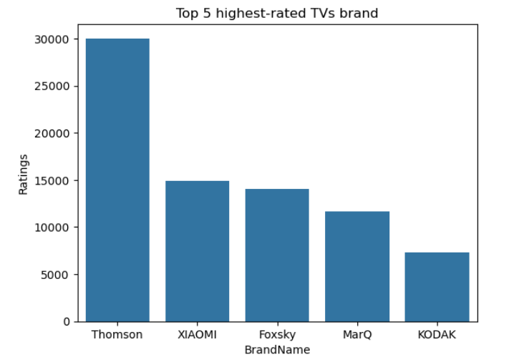
Bivariate Analysis: b/w Brand and Rating (to find top 5 rated brand) :
Description :
1. The bar chart represents the Top 5 highest-rated TV brands based on customer ratings data. Among all brands, (Thomson) shows the highest number of ratings, indicating strong customer engagement and popularity in the dataset
2. XIAOMI and Foxsky follow as the second and third highest-rated brands, demonstrating competitive market performance and significant customer feedback compared to other brands

Slide 11
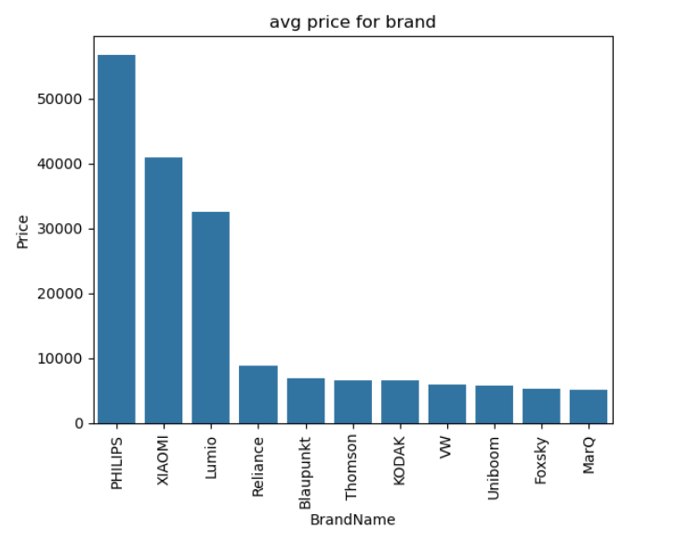
Analysis of Avg price for Brand (brand and price) :
1. The bar chart illustrates the average price distribution across different TV brands. Among all brands, (Philips) has the highest average price, indicating its positioning in the premium market segment.
2. XIAOMI and Lumino follow as the second and third highest-priced brands, suggesting a mid-to-premium pricing strategy

Slide 12
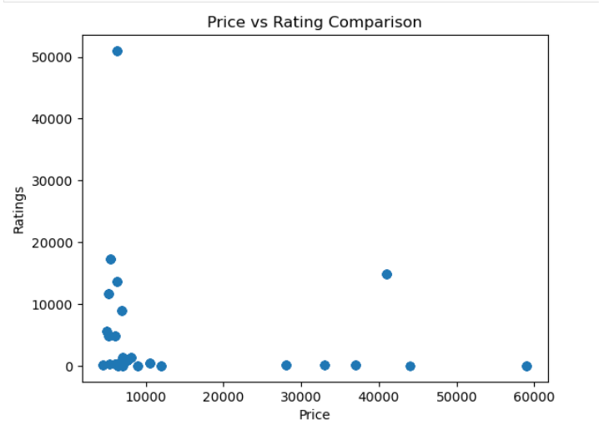
Analysis on rating vs price comparison(to know customer opinion):
1. The scatter plot represents the relationship between TV price and the number of customer ratings. Each data point corresponds to a product, showing how ratings vary across different price levels.
2. The majority of products are clustered in the lower price range (below ₹10,000), indicating that budget-friendly customer ratings.

Slide 13
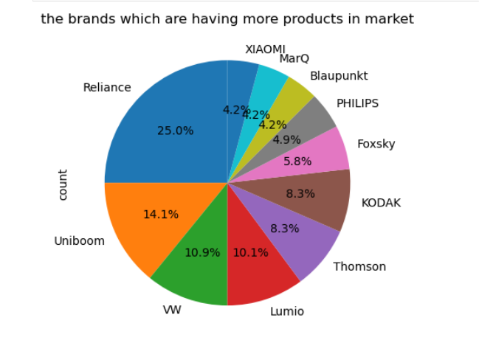
Univariate Analysis of Brand(to know which one having more products):
1. The pie chart illustrates the distribution of TV brands based on the number of products available in the market. It highlights each brand’s percentage contribution to the total product count.
2. Reliance holds the largest market share with approximately 25%, indicating the highest number of available products among all brands.

Slide 14
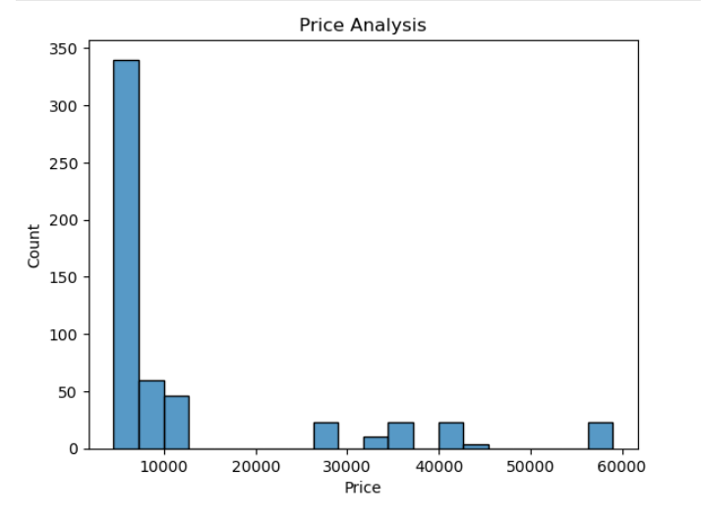
Price Analysis: (price vs customer satisfaction)
1. The histogram represents the distribution of TV prices in the dataset. It shows how frequently products fall within different price ranges.
2. The majority of TVs are concentrated in the lower price range (approximately ₹5,000 – ₹10,000), indicating that the market is largely dominated by budget-friendly models.

Slide 15
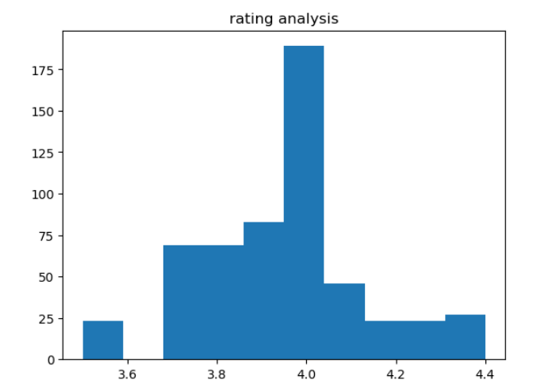
Rating Analysis (histogram )
1. The ratings predominantly cluster around 4.0, indicating that most observations fall within a high-rating range, suggesting generally positive evaluations
2. The distribution appears slightly concentrated between 3.7 and 4.2, with fewer instances at the lower (around 3.5) and higher (above 4.3) extremes

Slide 16
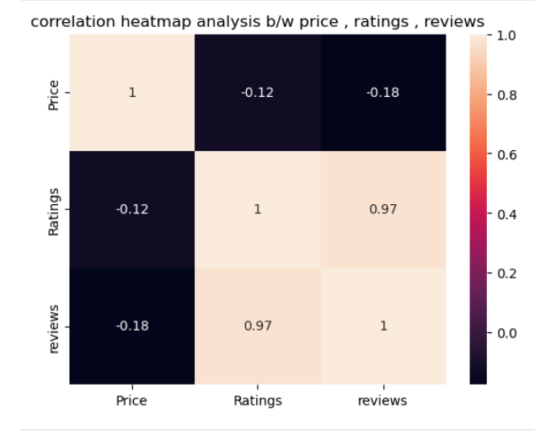
Multi-variate Analysis:b/w price , ratings and reviews as (to know relation b/w them):
1. a correlation heatmap tells the relationship between Price, Ratings, and Reviews
2. A strong positive correlation (0.97) is observed between Ratings and Reviews, indicating that items with higher ratings tend to receive a greater number of reviews.

Slide 17
Key BusinessQuestion:
1. is customers are always prefer expensive products ?
ans : NO
2. What are the top rated brandss ?
ans : Thomson and Xiaomi
3. What is the min avg price starting from ?
ans : it’s starts from 10k
4. Are expensive TV’s better rated ?
ans : NO

Slide 18
Conclusion (Key finding overal) :
1. the thomson and xiaomi are having more ratings by customers in market
2. Majority of products fall in medium price range
3. Most products have average ratings (3.5 stars)
4. No strong correlation between price with respect to ratings and reviews
5. the reliance and uniboom having more products in market
This tells us :
* Customers do not always prefer expensive products. they look less price one having better ratings
* that ratings aslo given by previous customer

Slide 19
Challenges Faced:
1. Understanding HTML & website structure
2. when scraping data from flipkat website
3. Avoiding of website blocking
4. data cleaning & manipulation of dataset

Slide 20
Your Experience working on Web Scraping :
1.This project helped me:
2. to gain real time project experience
3. Understand real-world data extraction
4. Improve data cleaning skills
5.Strengthen EDA techniques
6. Gain practical industry exposure

Slide 21


Slide 22

THANK YOU

